Slide 1
TEAM MEMBERS: A.N.Jayakeerthi(412513104044) R.Pavithra(412513104081) V.Prithikka(412513104087)
INTEGRATION OF MULTI BANK MULTI USER IN SINGLE CARD WITH USER BEHAVIOR MONITORING USING HMM & FORMULA VERIFICATION
GUIDED BY:
Mrs.M.Kiruthiga Devi,M.E.
SRI SAIRAM ENGINEERING COLLEGE

Slide 2
ABSTRACT
Usage of ATM cards for transaction has become very common. Managing multiple cards has become tedious. RFID smart card is used as ATM Card for transaction. Multiple bank accounts of single user and multiple users are to be integrated in a single card. Users can access their cards with unique identity numbers accordingly. Users can include their family members’accounts details in the same card and their behavior is monitored through HMM algorithm, verified using OTP and authenticated using formula based method.

Slide 3
OBJECTIVE
To integrate multiple accounts of multiple banks in a single card.
To overcome an emergency situation where the user don’t have money in his/her account.
To enhance security and to prevent unauthorized access formula based authentication and user behavior tracking with HMM model is used

Slide 4
EXISTING SYSTEM
In the existing system big data is used in many applications in banking sector such as fraud detection and prevention .
Big data is also used to provide enhanced compliance to cater billions of customers’ needs in a meaningful way.
RFID cards are used in item level inventory tracking and attendee tracking.

Slide 5
LITERATURE SURVEY
TITLE | AUTHOR | JOURNAL/ CONFERENCE | FINDINGS | SCOPE FOR FUTURE USE
Recent Development in Big Data Analytics for Business Operations and Risk Management | Tsan-Ming Choi | IEEE Trans. Cybern,May 2016 | Used for fraud detection and prevention | Shoulder surfing can be prevented and security can be improved.
Fraud Detection by Monitoring Customer Behavior and Activities | P Singh | IEEE Trans. Cybern, June 2015 | HMM Model is used for user behavior monitoring | Drastic change can be detected and sms alert can be used.
Credit Card Fraud Detection Using Hmm And Image Click Point Authentication | Dinesh L.T, K.P. Adhiyaalekar | IEEE journal 2015 | Authentication using image | Formula based authentication can be used

Slide 6
LITERATURE SURVEY
TITLE | AUTHOR | JOURNAL/CONFERNCE | FINDINGS | SCOPE FOR FUTURE USE
Developing Data Cloud Services in Various Environments | S.Nageswara Rao, B.R.M.Reddy | International IEEE journal 2015 | Cloud services are used in various applications and fields | Use of cloud technology to manage the bank database and user entries
Application Framework and Data Processing in IoT based Email System | Vishakha More1, Prof. Raghib Nasri2 | International IEEE journal June 2016 | In IoT enabled systems data from all connected devices can be generated quite rapidly the volume may be huge and types of data can be various. | Aims to provide a framework which would allow or facilitates the users to create their IoT applications.
Security Threats on cloud Computing Vulnerabilities | Te-Shun Chou | International IEEE Journal,June 2013 | The security issues associated with cloud computing make us vulnerable to cybercrimes that happen every day. | Three cloud service models were compared to demonstrate the techniques that hackers used against cloud computing systems.

Slide 7
PROPOSED SYSTEM ARCHITECTURE DIAGRAM
BEHAVIOR MONITORING USING HMM
FORMULA BASED AUTHENTICATION
INTEGRATE MULTIPLE BANKS AND ACCOUNTSS
REGISTER FAMILY MEMBERS
CASH TRANSACTION
USER
SMART CARD

Slide 8
PROPOSED SYSTEM
In this system multiple accounts are integrated in a single card. When the user creates a account a formula is to be attached to his account.(any variable (a-z), arithmetic sign(+,-)).
As the user swipes the RFID card, various accounts linked to it are displayed where he/she needs to choose one.
If the user chooses his/her own account the user behavior is tracked using HMM , if there is the drastic change in the behavior the panel with variables and their corresponding value is displayed .

Slide 9
PROPOSED SYSTEM
The user computes using his formula and withdraws the amount required.
If the user chooses some other account, the user behavior is checked and the OTP is send to the corresponding account owner, and the formula is revealed to the user.
He computes value after the panel is displayed, enters the OTP and withdraws the cash.
The owner can change the formula n number of times.

Slide 10
ALGORITHM AND METHODOLOGY
HMM(Hidden Markov Model)
A statistical Markov model in which the system being modeled is assumed to be a Markov process with unobserved (hidden) states. An HMM can be presented as the simplest dynamic Bayesian network.
Formula based algorithm
A panel is displayed and the value for a particular formula is to be computed.
SMS Alert Algorithm
To notify the user about unauthorized transactions

Slide 11
LIST OF MODULES
Creation of database for storing user details.
Integration of multiple banks and multiple user in RFID card.
Tracking of transaction using HMM Model.
Formula based authentication.

Slide 12
CREATION OF DATABASE FOR STORING USER DETAILS
In this module the user needs to create an account and then they are allowed to access the Network.
Once the user creates an account, they login into their account and requests the job from the service provider. Based on the user’s request, the service provider will process the user’s request and respond to them.
All the user details will be stored in the database of the Service Provider. The user Interface frame is designed to Communicate with the Server using programming language like java.
By sending the request to Server Provider, the User can access the requested data if they are authenticated by the Service Provider.

Slide 13
CREATION OF DATABASE FOR STORING USER DETAILS
Bank Service Provider contains information about the users in their Data Storage.
Bank Service provider also maintains all the User information that are required for the authentication of the user at the time of logging into the account.
The User information will be stored in the Database of the Bank Service Provider.
To communicate with the Client and the with the other modules of the Company server, the Bank Server will establish connection between them. For this Purpose User Interface Frame is created.

Slide 14
INTEGRATION OF MULTI BANK AND MULTI USER
In this module, design and implementation of family member registration is considered. Using single card like credit and debit for entire family members.
But maintain unique PIN numbers for different banks. We will provide a button add “Family card” in our user card.
Now user can add his family members bank atm details also along with pin number details. User can include like further bank account no, bank name, pin number same way for other family members also.

Slide 15
TRACKING TRANSACTIONS USING HMM
Hidden markov model used for user behaviour analysis of cash withdrawal. Hidden markov model is applied to understand users money withdrawal sequence in which first condition is total amount withdrawal in every month.
Second one is Frequency of withdrawal of money using credit card. User can withdraw the cash as per money requirement and time frequency is also monitored & recorded.
During registration of the card, user has to give a formula for secured authentication system. User can also add multiple bank accounts in single card.

Slide 16
FORMULA BASED AUTHENTICATION
In this module, We provide security by using formula like (A+B-C) while registration. In this formula using alphabets and two operators like (+ and -).
The formula is constant, but numbers will randomly change for every transaction. User is not required to provide the formula at any time, user is only required to submit the answer after substitution of the corresponding values in their formula.
This formula based authentication is required only when user tries to withdraw money beyond the permitted 10% extra and increases the withdrawal frequency.
Once user is registered by specifying his master bank account details & formula for authentication. Now user can add his family card details also.

Slide 17
REQUIREMENTS
Hardware Requirements
Processor :Core i3/i5/i7
RAM :2-4GB
HDD :500 GB
Embedded Fabrication Kit
Software requirements
Platform: WindowsXp/7/8
Front End : Java-JDK1.7
Back End : MYSQL
Embedded C
Big Data:ApacheHadoop -2.5

Slide 18
ADVANTAGES
This system reduces multiple numbers of ATM cards for every account.
Shoulder surfing attack is prevented.
User can withdraw cash using their single ATM card from their family members’ account in case of emergency.
Security is ensured by the implementation of formula based authentication.
Big data helps to analyze huge volume of data.

Slide 19
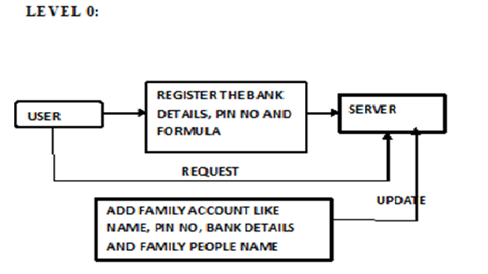
DATA FLOW DIAGRAM

Slide 20
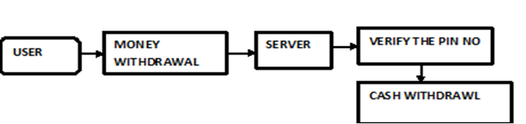
LEVEL 1
DATA FLOW DIAGRAM

Slide 21
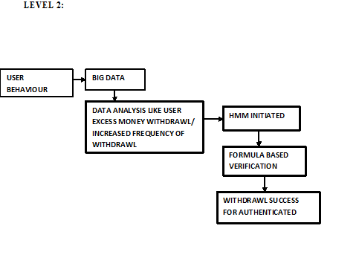
DATA FLOW DIAGRAM

Slide 22
REFERENCES
[1]Tsan-Ming Choi, Member, IEEE, Hing Kai Chan, Senior Member, IEEE Trans. Cybern, and Xiaohang Yue, May 2016.
[2] K. Govindan, A. Jafarian, M. E. Azbari, and T.-M. Choi, “Optimal bi-objective redundancy allocation for systems reliability and risk management,” IEEE Trans. Cybern., May 2016
[3] N. Manwani and P. S. Sastry, “Noise tolerance under risk minimization,” IEEE Trans. Cybern., vol. 43, no. 3, pp. 1146–1151, Jun. 2013.

Slide 23
REFERENCES
[4] B. Shen, T.-M. Choi, Y. Wang, and C. K. Y. Lo, “The coordination of fashion supply chains with a risk-averse supplier under the markdown money policy,” IEEE Trans. Syst., Man, Cybern., Syst., vol. 43, no. 2, pp. 266–276, Mar. 2013.
[5] G. M. Gaukler, “Item-level RFID in a retail supply chain with stockout- based substitution,” IEEE Trans. Ind. Informat., vol. 7, no. 2, pp. 362–370, May 2011.

Slide 24
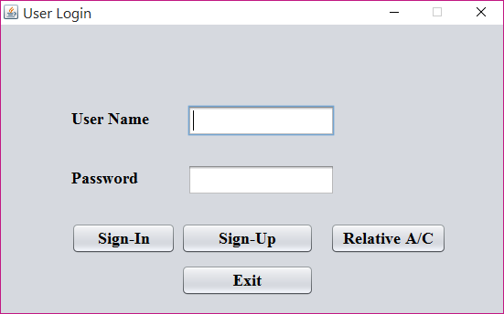
SCREENSHOTS

Slide 25
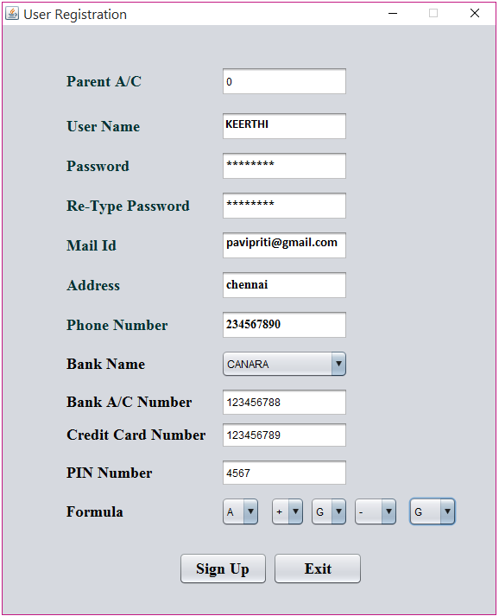

Slide 26
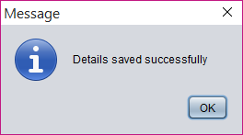
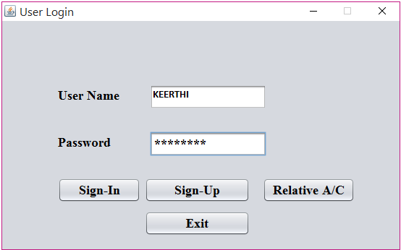

Slide 27
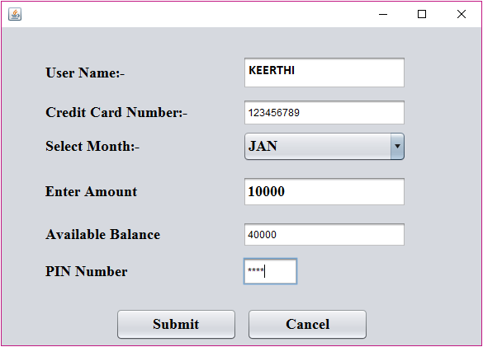
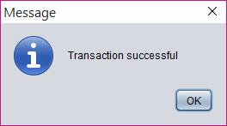

Slide 28
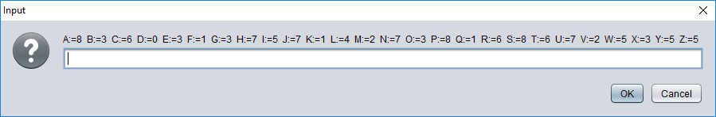
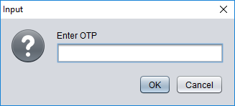
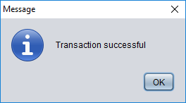

Slide 29
THANK YOU

